Slide 1


Acadex Nexus
Team: 23
Monisha M
Harsavardhini R
Tanushri G V S
Kaviya S

Slide 2

Problem Statement
Students and teachers often find it hard to communicate well and manage their academic work because they don't have one main place to work together. Homework, exams, and research projects are spread out over many different systems, which makes it tough to keep an eye on progress and involvement. Students have a hard time getting learning that fits their needs, while teachers struggle to guide students and handle their academic duties.

Slide 3
Solution
Our project is an academic platform that enhances academic collaboration between students and teachers. It features smart mentor matching, AI-driven test generation & evaluation, and automated performance analytics to help students improve. Teachers can create exams using AI, assign homework, and track student progress easily. This platform boosts productivity, personalized learning, and efficient academic management.

Slide 4
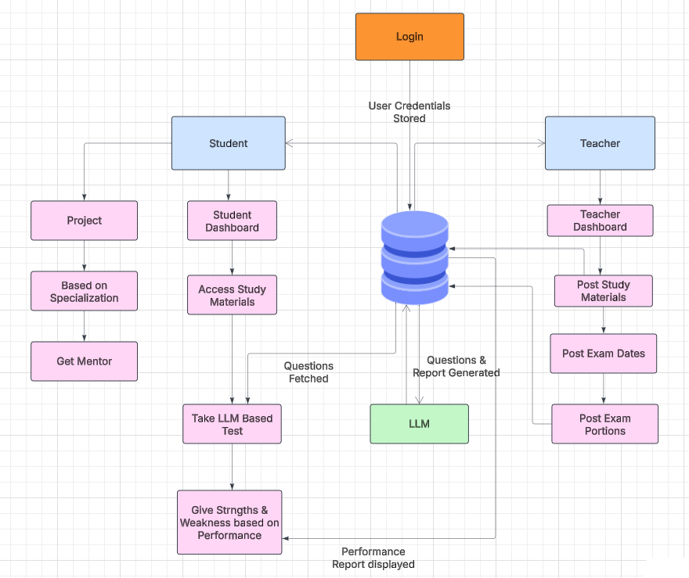
SYSTEM ARCHITECTURE

Slide 5
LLM BASED QUESTION GENERATOR
Stage
1
Stage
2
Stage
3
Stage
4
Stage
5
Stage
6
Staffs assign test and its respective portions from their dashboard
Students obtain that information on their dashboard
A button is provided for attempting mock test based on portions
Each students gets different sets of questions
Questions are generated and evaluated by LLMs
Strength and weakness of the particular student would be analysed and report is genrated by the LLM

Slide 6






PROJECT MENTOR SELECTION
Stage 2
Stage 4
Gets connected to the staff with the selected domain
Staff can accept or reject based on their availability and interest
Stage 6
Students can contact and work with the staff
01
02
03
04
05
06
Stage 1
Stage 3
Stage 5
Student select their project and domain
Student selects and request for guidance from the staff
If availability count exceeds that staff cant be selceted

Slide 7
Tech Stack
 | React
LLM
1
Frontend
2
Backend
Django
3
Database
Sqlite3
4
Mistral:7b-instruct

Slide 8

THANK YOU

